Slide 1
MEASUREMENT DESIGN
Subject Code- FT-210 – Research Methods
Dr.Yamini Karmarkar
International Institute of Professional Studies
Devi Ahilya University
Indore

Slide 2
Learning Objectives
Define measurement and scaling
Different types of scales
Validity in measurement
Reliability in measurement
Details on questionnaire construction
Sampling Techniques

Slide 3
Measurement
The assignment of numbers to objects to represent amounts or degrees of a property possessed by all of the objects (Kerlinger 1973)
But Subjective concepts are difficult to measure. They are measured by breaking down the abstract notions into observable characteristics (operationalisation).
eg : thirst – concept → thirst level → quantity of fluid consumed in one go.

Slide 4
Operationalisation
c
Learning
D
D
D
Understanding
Retention
Application
E
E
E
E
E
Answer questions correctly
Give Appropriate examples
Recall material after some lapse of time
Solving problems on the basis of understanding and retention
Integrate with other relevant material

Slide 5
Operationalisation
c
Investment
D
D
Earn returns
Deploy savings
E
E
E
E
E
Shares
Futures & Options
Mutual Funds
Fixed Deposits
Post office savings

Slide 6
Data Collection Techniques
Administering a standard instrument already developed.(Primary data)
Administering a specially designed instrument like questionnaire.(Primary data)
Extracting already measured data from records.(Secondary data)

Slide 7
Scale
A tool or mechanism by which individuals, events or objects are distinguished on the variables of interest in some meaningful way.
Scaling is a procedure for attempting to determine quantitative measures of subjective abstract concepts.
Levels of measurement – Nominal, Ordinal, Interval, Ratio

Slide 8
Nominal Scales
Lowest level, classifying the objects into categories. Very limited statistical techniques can be applied
Examples : -
Where do you live city town village
Do you own a car Yes / No
Do you invest in financial instruments Yes / No

Slide 9
Ordinal scale
It includes characteristics of nominal scale. It ranks the objects. Limited statistical techniques can be applied.
Example :
Please rank the following products in order of your choice
  Fixed Deposits ______
  Shares ______
  Futures & Options ______
  Mutual Funds ______

Slide 10
Interval Scale
It has all characteristics of nominal and ordinal scales, and in addition the units of measurement are equal. A truly quantitative scale. All statistical techniques can be applied.
Example:-
The highest safety for your money is in investing it in bank fixed deposit.
Strongly agree Agree Neither/ Nor Disagree Strongly Disagree
(1) (2) (3) (4) (5)

Slide 11
Ratio Scale
It is like an interval scale with true zero point (natural origin), possess all qualities of a number system – equality, rank order, equality of intervals and equality of ratios.
Example :-
i) How much percentage of your investment is in fixed deposits ?
1- 20 | 21- 40 | 41-60 | 61-80 | 81-100
1 | 2 | 3 | 4 | 5

Slide 12
Validity & Reliability
× -Valid
× - Reliable
× -Valid
√ - Reliable
√ -Valid
√ - Reliable

Slide 13
Validity of measurement
Refers to whether the research actually measures what it says it’ll measure. Validity is the strength of our conclusions, inferences or propositions.
  Internal Validity: the difference in the dependent variable is actually a result of the independent variable
  External Validity: the results of the study are generalizable to other groups and environments outside the experimental setting
  Conclusion Validity: we can identify a relationship between treatment and observed outcome
  Construct Validity: we can generalize our conceptualized treatment and outcomes to broader constructs of the same concepts

Slide 14
Reliability of Measurement
Stability and consistency with which instrument measures
Methods to test reliability
    Test –Retest method
    Split Half Reliability Test
    Chronbach α or spearman brown coefficient are measures of reliability and can be calculated using a software.

Slide 15
Scaling Techniques
Rating scale
  Dichotomous scale
  Category scale
  Likert scale
  Semantic differential scale
Ranking scales
  Paired comparisons
  Forced choice

Slide 16
Methods for collecting data
Sources of Data
  Primary vs Secondary Data
  Focused groups, individuals
  Techniques for data collection
  Interviewing (face to face , telephonic)
  Questionnaires (personal, mailers, e-mailers)
  Observational Studies (Experimentation)

Slide 17
Questionnaire Construction some tips
Personally administered or mailed
Things to be taken care of –
  Wording of the questionnaire
  Measurement techniques
  General getup

Slide 18
‘Wordings’ in Questionnaire
Content and purpose
Language & wording
Type & Form of questions
  Open ended vs close ended
  Positively and negatively worded questions
  Ambiguous vs clear questions
Length of questions
Sequencing of questions
Personal information

Slide 19
‘Measurement’ in questionnaires
Statistical analysis technique must be decided beforehand
Scaling of variables, levels of measurement should be pre-decided
Coding method must be decided beforehand
‘Getup’ of questionnaires
Neat and tidy, legibility
Brief introduction
Natural flow
Proper instructions

Slide 20
Sampling Techniques

Slide 21
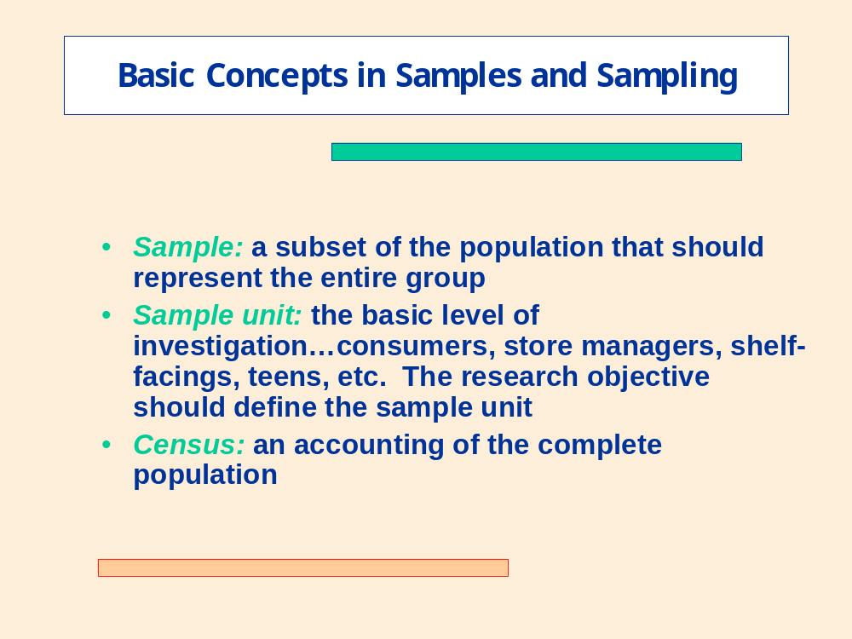
Sampling
Population, Element, Sample, Sampling
Representativeness of the sample
Sample data and hypothesis testing

Slide 22
Sampling techniques
Probability Sampling vs Non Probability Sampling.

Slide 23
Basic Sampling Classifications
Probability samples: ones in which members of the population have a known chance (probability) of being selected. It Ensures representative-ness as well as precision
Non-probability samples: instances in which the chances (probability) of selecting members from the population are unknown

Slide 24
Probability Sampling
Simple Random Sampling
Systematic Sampling
Stratified Random Sampling
Cluster Sampling
Area Sampling

Slide 25
Simple Random Sampling

Slide 26
Systematic Random Sampling

Slide 27
Stratified Vs Cluster Sampling
Although strata and clusters are both non-overlapping subsets of the population, they differ in several ways.
All strata are represented in the sample; but only a subset of clusters are in the sample.
With stratified sampling, the best survey results occur when elements within strata are internally homogeneous. However, with cluster sampling, the best results occur when elements within clusters are internally heterogeneous

Slide 28
Non- Probability Sampling
Convenience sampling
Judgment sampling
Quota Sampling
Snowball Sampling

Slide 29
Probability or Non-probability?
Factors | Non Probability | Probability
Nature of research | Exploratory | Conclusive
Ratio of sampling vs. non-sampling errors | Large non-sampling | Large sampling
Variability in population | Homogenous | Heterogeneous
Statistical Consideration | Unfavorable | Favorable

Slide 30
Thank You

